Slide 1

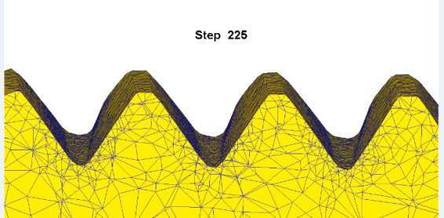
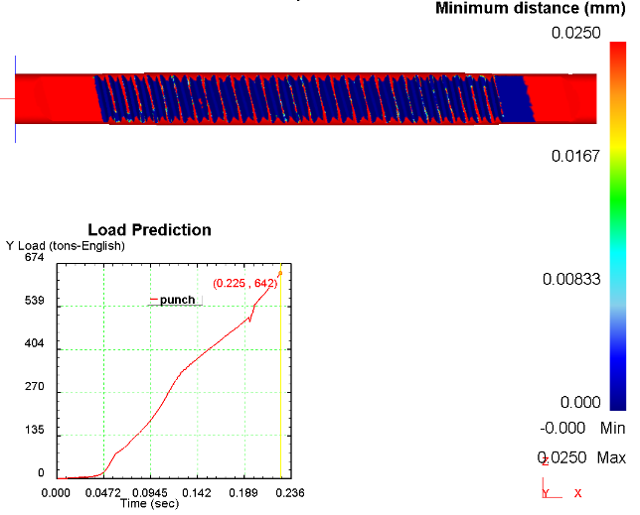
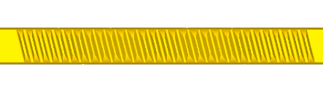

Cut and Coin – BMW
Cut Form
Note – No mid-plane tooth laps
Tonnage & Fill
Cut Form
Finished Teeth

Slide 2
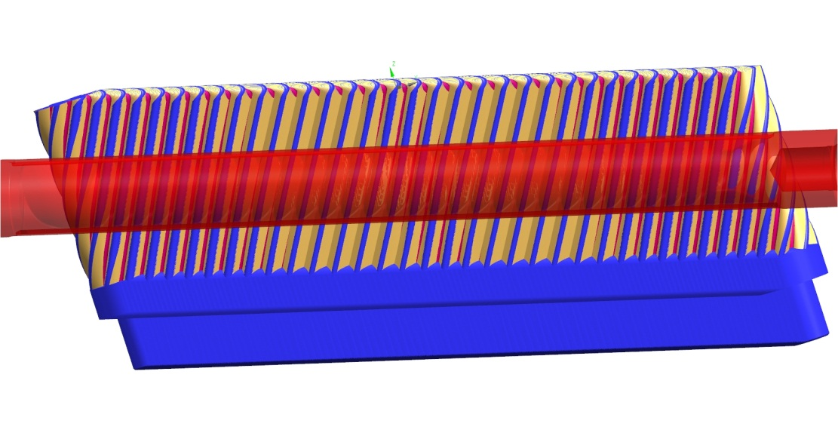
Variable Ratio Rack Development
Rack Technology team now headed by Bill Anders
Completed Die set for forming operation
Completed forming by cut and coin of 9 tooth T1 rack
Shifting focus to developing BMW rack by cut and coin

Slide 3
Variable Ratio Rack by cut and coin
Process used to manufacture Variable Ratio Racks
Manufacture straight ratio racks by milling
Use hydraulic press to coin the teeth into the VR geometry
Not the same as G-Car - entire tooth mesh is coined to provide seamless transitions
Suitable for applications such as BMW.
Capital investment limited to pressing operation to coin teeth
Remaining processing remains same as straight ration production

